Slide 1

PROPOSAL
Dr Rashmi R Borah
Assistant Professor of English
School of Social Sciences & Languages
VIT ,Chennai
rashmirekha.borah@vit.ac.in

Slide 2

How to write
A WINNING PROPOSAL

Slide 3
Definition
Purpose
Types
Structure

Slide 4
Proposal
A proposal is a document where you introduce your product/process/service
Explain how it can help solve the recipient's/client’s issue
Identify the company's plan for execution
Provide technical details of the deal

Slide 5
Purpose
To persuade
To construct
To design
To undertake

Slide 6
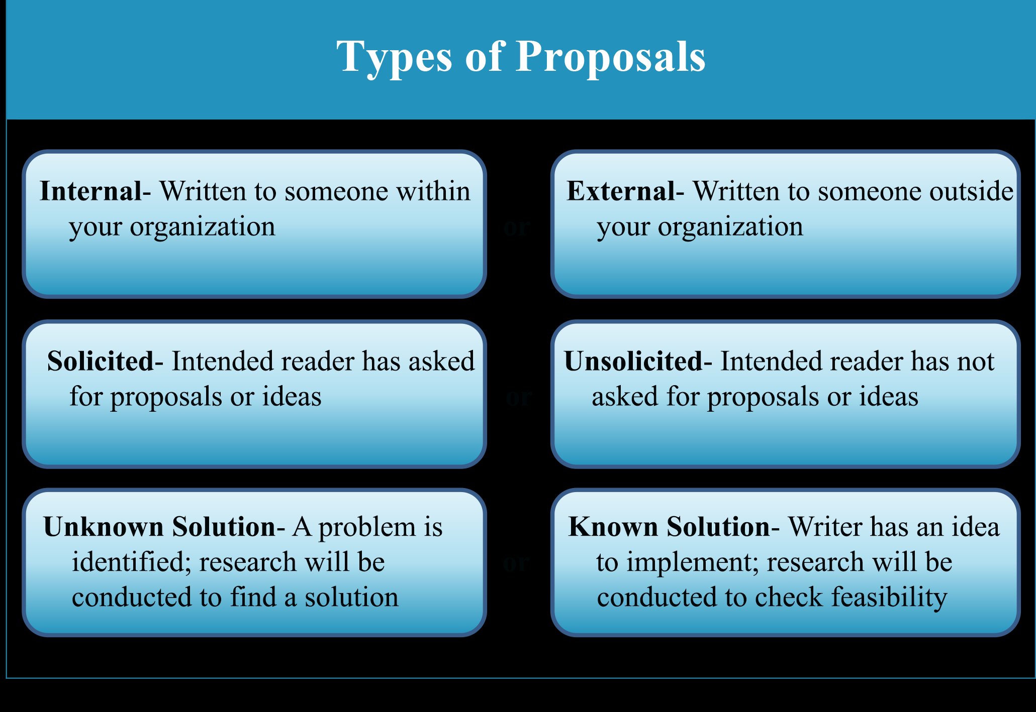

Slide 7
Reports | Proposals
contain information about what has happened in the past | examine what may happen in the future
record objective facts | aim mainly to persuade the reader to make a specific decision
to provide information is the main aim | express opinions, albeit supported by objective facts

Slide 8
Parts of a Proposal
T
A
I
P
O
LI
ME
R

Slide 9
TAIPOLIMER
Title
Abstract
Introduction
Problem Statement
Objective
Literature Review
Methodology
Reference

Slide 10
TITLE
Title #1 - Red Haired Musicians and their Preference for Musical Style
Title #2 - Music Style Preference of Red Haired Musicians

Slide 11
Introduction
What is the central research problem?
What is the topic of study related to that problem?
What methods should be used to analyze the research problem?
Why this RESEARCH is important , and why should someone reading the proposal care about the outcomes from the study?

Slide 12
Research Proposals Make You
OUTLINE STEPS IN YOUR PROPOSED RESEARCH
THINK THROUGH YOUR EXPERIMENTS
PROVIDE INTELLECTUAL CONTEXT
JUSTIFY YOUR RESEARCH
CREATIVE
ANTICIPATE POTENTIAL PROBLEMS

Slide 13
Essential Ingredients
The Issue
What problem does the research address?
Research Design How will the research achieve its stated objectives?
Benefit
What will the research contribute to existing knowledge?

Slide 14
How to write a Proposal
EXECUTIVE SUMMARY / ABSTRACT
RESEARCH BACKGROUND &DISCUSSION
METHODOLOGY/APPROACH
Objectives
Statement of Work (also called Work Plan)
Project Tasks
Project Schedule
Cost
Capabilities
ANTICIPATED BENEFITS OF PROPOSED WORK
ANTICIPATED ENVIRONMENTAL IMPACT OF PROPOSED WORK
REFERENCES
APPENDICES

Slide 15
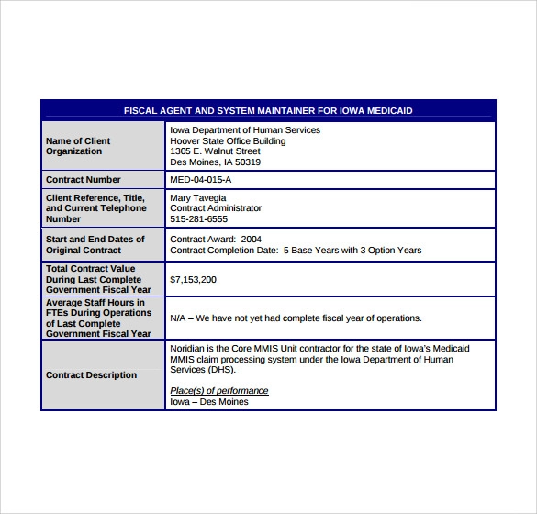
Sample 1

Slide 16
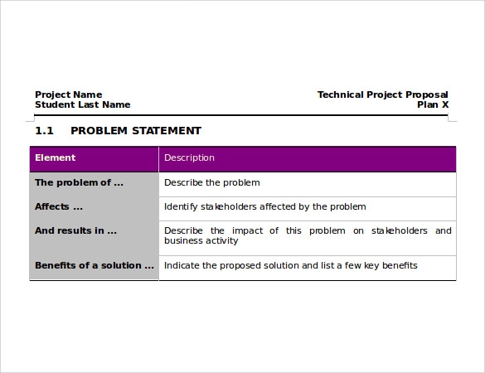
Sample 2

Slide 17
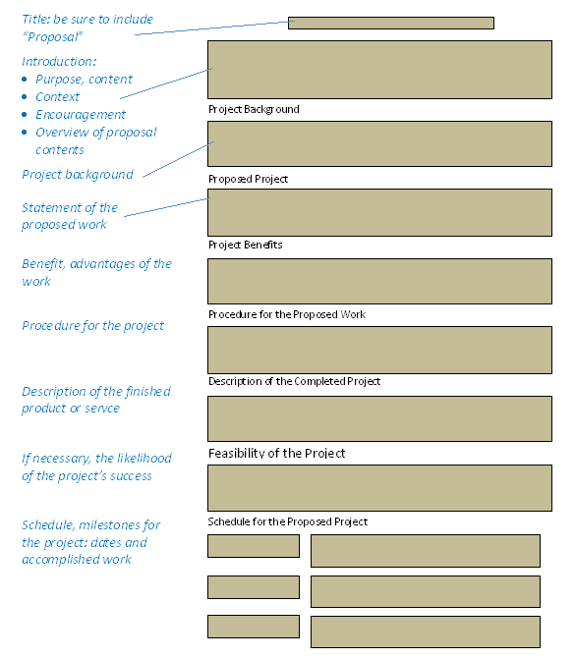
Sample 3

Slide 18
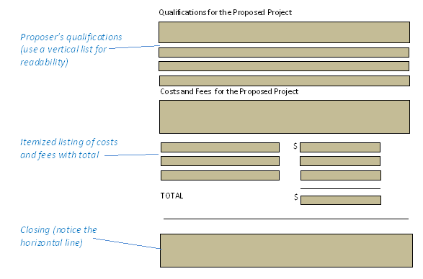

Slide 19


Slide 20
Funding Agencies
UGC
ICSSR
All India Council for Technical Education (AICTE)
Industry Institute Partnership Cell (IIPC)
Entrepreneurship Development Cells (EDC)
National Facilities in Engineering & Technology with Industrial Collaboration (NAFETIC)
Council of Scientific and Industrial Research (CSIR)
DRDO
Department of Atomic Energy (DAE)
Department of Science and Technology (DST)
Department of Scientific and Industrial Research (DSIR)
Indian Council of Medical Research (ICMR)
India Meteorological Department (IMD)

Slide 21
Sources
www.plainenglish.co.uk
https://www.prismnet.com/~hcexres/textbook/props.html

Slide 22
Thank you

